Slide 1
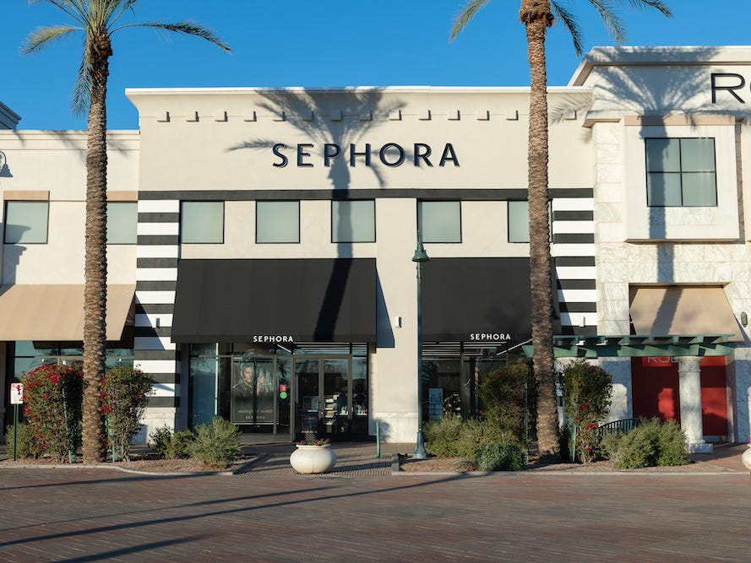
Bringing Sephora to Oxford
By: Zoe Haas, Skylar Jeffers, Abigail Cademartori, Maeve McCracken, and Reagan Gamble
Notes:
Someone say title, everyone say their own name

Slide 2

Overview of Sephora’s Global Business Model
Global Presence and History:
  Founded in 1969 in Limoges, France; now boasts approximately 2,700 stores across 35 countries and 500 stores in the United States.
Innovation in Retail:
  Pioneered the open-sell environment allowing customers to test products, revolutionizing the beauty retail landscape.
Strategic Subsidiary:
  Operates as a subsidiary of LVMH, enhancing its reach and influence within the luxury market.
Customer-Centric Practices:
  Notable for its interactive store layouts and consumer0friendlt policies, including a 30-day full refund and 60-day store credit.
Product Diversity and Specialization:
  Offers an extensive range of beauty and personal care products from high-end brands, continually updating its assortment with exclusive and limited-edition items.
Notes:
REAGAN
Global Presence and History:
Founded in 1969 in Limoges, France helped to foster Sephora's origins and expansion as a major player in the global beauty market. Its significant U.S. presence, with over 2,700 stores emphasizes the strategic importance of its market position.
Innovation in Retail:
Sephora’s open-sell environment on the beauty industry, has transformed the way beauty products are marketed and sold by encouraging hands-on customer interaction.
Strategic Subsidiary:
Being part of LVMH, a leader in the luxury goods industry, provides Sephora with a competitive edge in terms of branding, resources, and global reach.
Customer-Centric Practices:
Sephora’s focus on customer experience is reflected in its store design and return policies, making it a favored destination for beauty enthusiasts looking for quality and assurance in their purchases.
Product Diversity and Specialization:
Sephora’s extensive product offerings emphasizes its commitment to variety, quality, and exclusivity. Sephora caters to a diverse customer base with products ranging from everyday essentials to luxury items, continually innovating to meet consumer demand.

Slide 3
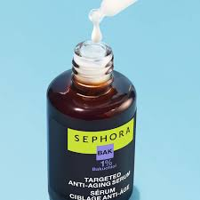
Target Market Assessment for Sephora
Primary Target - Silver and Gold Demographic:
  Median age of 60.5 years, with 70% aged 55 and older, providing a market with specific skincare and haircare needs.
Product Preferences:
  Preference for maintenance and preventative treatments; high demand for travel-sized items and quality sunscreens due to active and outdoor lifestyles.
Economic Power:
  56% of households earn wages, indicating disposable income; frequent travel, and outdoor activities.
Brand Preferences:
  Favors clean, age-friendly brands like Clinique and Dr. Jart+, which cater to mature skin and health-conscious consumers.
Comparative Market Analysis:
  Chose Silver and Gold over Midlife Junction and Simple Living due to higher spending capacity and brand alignment with Sephora’s product offerings.
Notes:
MAEVE
Our target demographic is the Silver and Gold group. With a median age of 60 and their love for outdoor hobbies, skincare and other products that focus on aging and existing damage are what they look for. Their preference for maintenance and preventative treatments and travel-sized products helps us better understand what they are looking for, for us to provide. Since 56% of these households earn income, we can predict them to have a disposable income that they would choose to spend towards taking care of themselves as they enjoy their outdoor hobbies and travel. This group favors clean, age-friendly brands like Clinique and Dr. Jart which cater to mature skin and health-conscious consumers. We chose Silver and Gold rather than other groups like Midlife Junction and Simple Living because they have a higher likelihood of spending money on products that they like that happen to align with our product offerings.

Slide 4
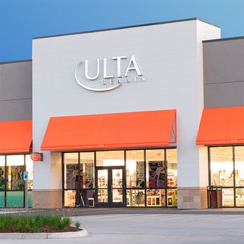
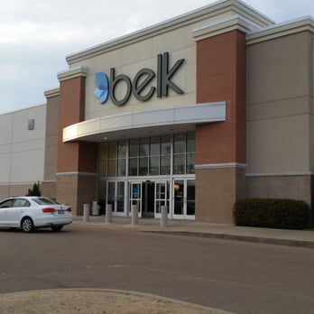
Sephora’s Competitive Analysis in Oxford
Ulta Beauty - Broad Product Range:
  Offers both drugstore and luxury brands, appealing to a wide demographic.
Ulta’s Strategic Pricing and Services:
  Ranges from $5 to $150+, with salon services that Sephora does not offer.
Belk - Targeting Mature Demographics:
  Focuses on luxury skincare and makeup, appealing to older, traditional shoppers.
Belk’s Market Strength:
  Established presence and trust, especially among the 50+ age group.
Sephora’s Differentiation Strategy:
  Emphasis on high-end beauty, exclusive brands, and personalized customer experiences.
Notes:
ZOE AND SKYLAR
Ulta Beauty - Broad Product Range:
Ulta Beauty's diverse offering includes brands like CeraVe, La Roche-Posay, YSL, and Dior, covering everything from affordable skincare to high-end fragrances. This breadth allows Ulta to cater to a variety of customers, from budget-conscious college students to luxury beauty enthusiasts.
Ulta's Strategic Pricing and Services:
Ulta’s pricing strategy and additional services like haircuts and coloring give it a competitive edge. These factors make Ulta a one-stop beauty shop, providing convenience and value that attract and retain a broad customer base.
Belk - Targeting Mature Demographics:
Belk’s focus on a more mature demographic with luxury brands like Estée Lauder and Lancôme. This positions Belk as a destination for customers seeking traditional department store experiences and high-quality, classic beauty products.
Belk's Market Strength:
Belk has a long-standing presence in Oxford, which has helped it build substantial brand loyalty, particularly among older consumers who value consistency and reliability in their shopping venues.
Sephora's Differentiation Strategy:
Finally, Sephora’s strategy to differentiate itself by focusing on upscale beauty solutions and creating an in-store experience that caters to discerning consumers looking for specialized products and personalized service. Mention how Sephora plans to attract the "Silver and Gold" demographic by offering products and services that address their unique needs, such as anti-aging skincare and a quieter, more navigable store layout.

Slide 5
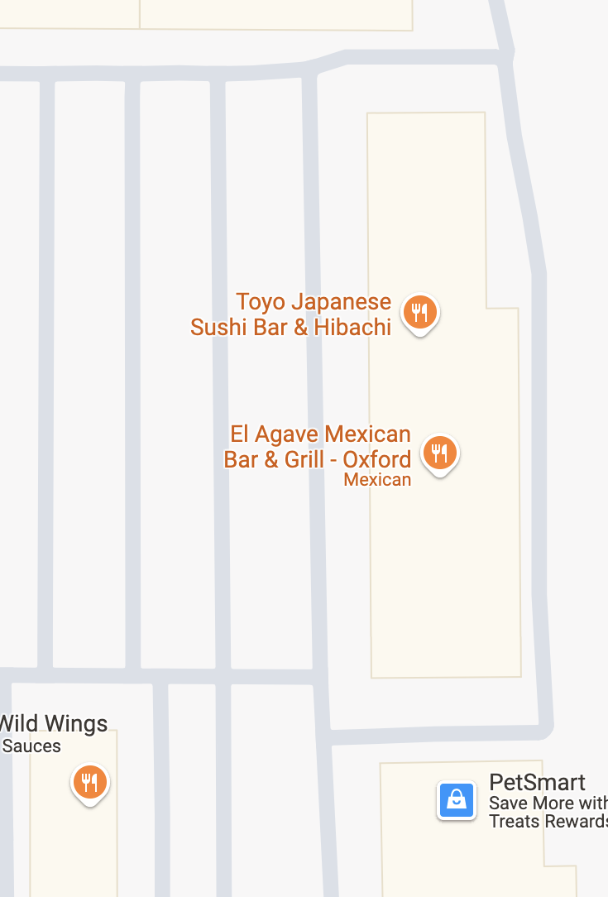
Choosing Site #4 for Sephora in Oxford
Strategic Location:
  Located in a buys shopping center alongside Belk, Buffalo Wild Wings, Newk’s, and El Agave.
Proximity to Competitors:
  Close to Ulta, allowing Sephora to capture overflow traffic and offer exclusive products not available at Ulta.
High Accessibility:
  Situated off Jackson Avenue, one of the most traveled roads in Oxford, ensuring high visibility and easy access.
Ideal Facility Features:
  Spacious 6,900 sq.ft. area allows for a comfortable shopping experience with room for extensive product displays and customer movement.
Flexible Lease Terms:
  One-year lease at $2,000 per month provides a trial period to assess location effectiveness without long-term commitment.
Notes:
Abigail- We decided to choose site #4, the shopping center near El Agave and Newk's off Jackson Avenue to implement our store. We chose this location due to the location of the anchor stores in the strip center such as Belk, the high accessibility of parking, the convenience of location

Slide 6
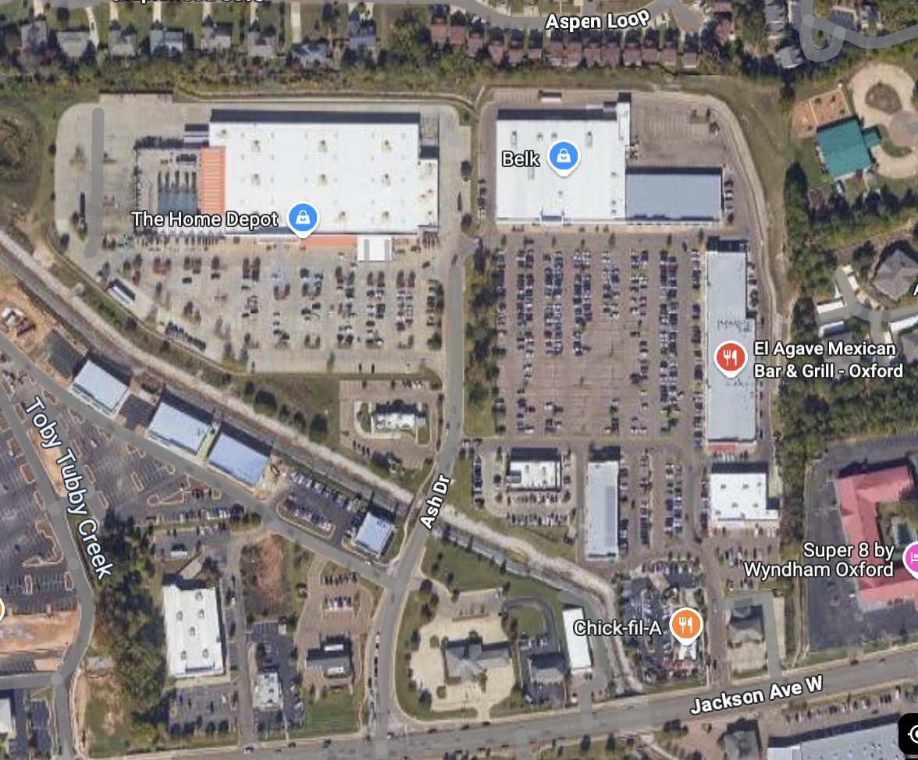
Choosing Site #4 for Sephora in Oxford (continued)
Advantages of Location:
  This site offers significant benefits including easy parking, potential to become an anchor site, and high foot traffic, enhancing customer convenience and store visibility.
Expansion Potential:
  Opportunity for expansion within the shopping center if adjacent stores become available, allowing for future growth without needing to relocate.
Accessibility Concerns:
  Despite being somewhat hidden behind other front-facing businesses like Chick-fil-A and a bank, the benefits of being in a well-trafficked strip center outweigh the initial visibility challenges.
Comparative Analysis:
  When compared to other potential sites (Site #2 and Site #6), Site #4 offers greater flexibility in store layout and is positioned in a more advantageous location for attracting Sephora’s target market.
Notes:
Abigail-

Slide 7
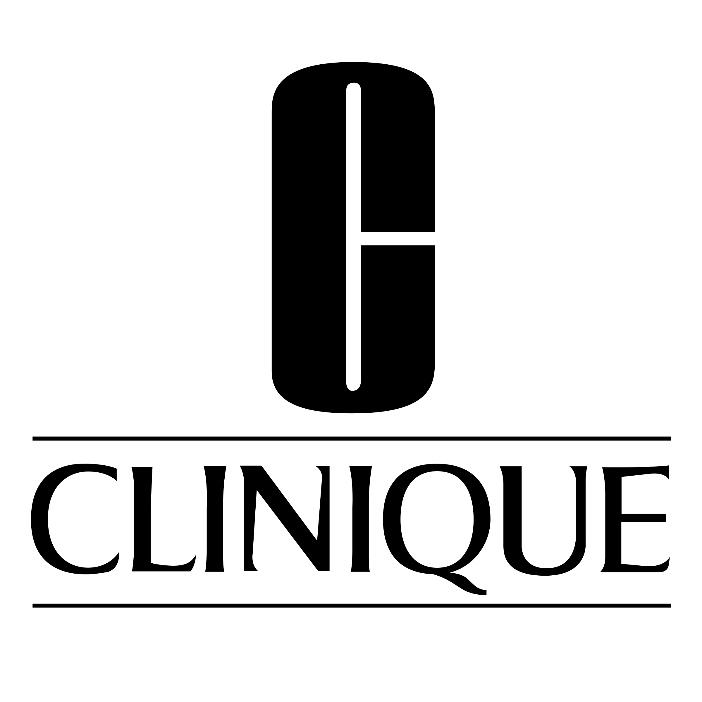


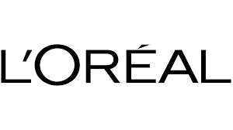
Merchandise & Brands Strategy
Targeting National Brands:
  Clinique, L’Oréal, Supergoop, and Chanel meet skincare and beauty needs of mature customers.
Private-Lavel – Sephora Collection:
  Offers high-quality, affordable, travel-friendly options aligned with clean beauty standards.
Brand Strategy for Silver and Gold:
  Emphasizes skincare, anti-aging, and sun protection for active, health-conscious older adults.
Prestige Branding Advantage:
  Sephora’s luxury image elevates even lower-prices items and resonates with aspirational buyers.
Branding Challenges and Solutions:
  Youth-focused image and limited age representation need balance with inclusive visuals and curated offerings.
Notes:
ZOE AND REAGAN
Targeted National Brands:
For our national brands we chose Supergoop, Clinque, Chanel and Loreal. Clinique and L’Oréal offer sensitive-skin and age-specific lines, while Supergoop focuses on sun protection—a key concern for older, active adults. Chanel brings the emotional appeal of timeless elegance and premium quality, ideal for women who want beauty that aligns with their lifestyle and self-image.
Private Label – Sephora Collection:
Sephora’s private brand called Sephora Collection, offers premium-tier quality at more accessible prices, without undercutting national brands. The Sephora Collection is especially appealing to older women who want smaller sizes for travel or testing, or who mix high and mid-tier products. Its participation in the “Clean at Sephora” program builds trust among ingredient-conscious shoppers.
Brand Strategy for Silver & Gold:
We’ll focus on preventative skincare, hydration, and anti-aging solutions. Travel-sized products, daily SPF, and fragrance-free options appeal to a demographic that travels, spends time outdoors, and seeks long-term skin health.
Prestige Branding Advantage:
Even a $15 product at Sephora feels premium, which aligns with older consumers who value quality and don’t mind paying more if the experience matches. Unlike competitors like Ulta, which offers more budget-based variety, Sephora appeals to those seeking curation and elegance.
Branding Challenges & Solutions:
Acknowledge the current perception that Sephora caters to a younger audience—TikTok trends, Gen-Z influencers, bold visuals, etc. To win older shoppers, we need more inclusive in-store visuals, staff who understand mature beauty needs, and more age-relevant signage. There is an importance of representing older women in marketing and balancing youth energy with wisdom, care, and comfort.

Slide 8
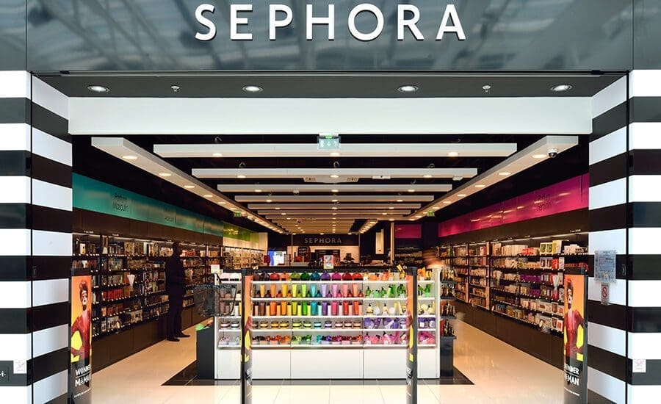
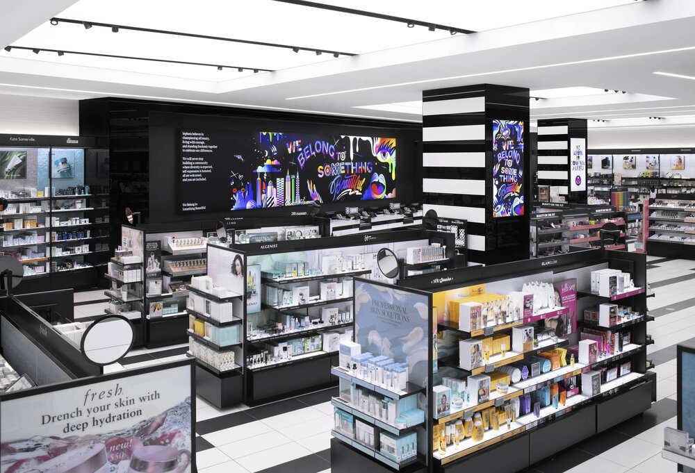
Managing the Merchandise
Category Captains Appointed by Department:
  Clinique (skincare), Laura Mercier (makeup), Chanel (fragrance), and Oribe (haircare) lead their respective categories.
Why Category Captains Matter:
  Provide deep expertise, improve product performance, optimize shelf space, and enhance merchandising strategy.
Oxford’s Demographic Fit:
  The Silver and Gold target market aligns with Sephora’s upscale focus and brand loyalty culture.
Local Competition Impact:
  Ulta is a strong presence but differs in pricing and product mix; Sephora provides exclusivity and a luxury experience.
Oxford Site Advantage:
  Convenient location, accessible parking, and solid oncome demographics support Sephora’s success potential.
Notes:
MAEVE
We decided to appoint a category captain for each department: Clinique will lead skincare, Laura Mercier will lead makeup, Chanel will lead fragrance, and Oribe will lead haircare. Each of these captains were specifically chosen as they already cater to our Silver and Gold group and will be able to lead other brands in each department by example. Our local competitor, Ulta, is strong but not for our demographic, as they offer differing pricing and product mix, where we offer what our group wants: luxury and exclusivity. Our sites advantageous because of its convenient location and accessible parking, which cater to our older shoppers. This combined with the city's strong local economy and spending power makes Oxford an ideal place for a new Sephora.

Slide 9
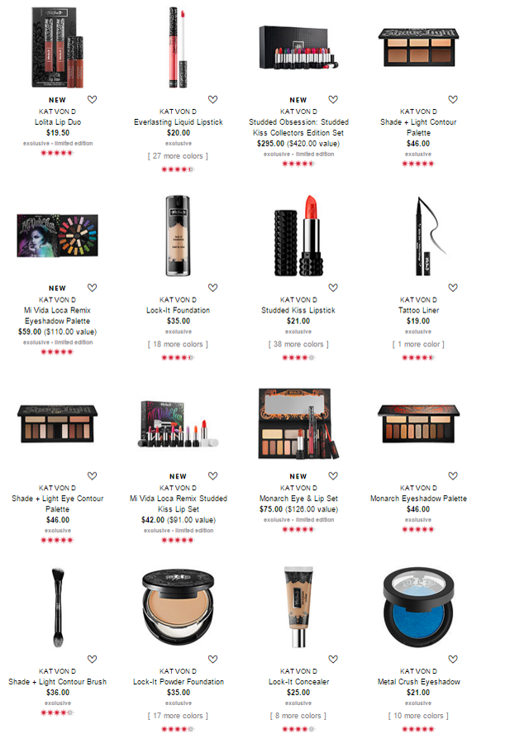
Merchandise Pricing Strategy
Primary Strategy - High/Low Pricing:
  Allows flexible pricing for luxury and private-label items; supports promotions and seasonal sales.
Target Market Fit:
  Appeals to both full-price luxury buyers and deal-seekers within the Silver and Gold demographic.
Supporting Tactics - Leader and Rounded Pricing:
  Use lower prices on staple products to increase traffic; rounded prices encourage emotional purchases.
No Variable Pricing:
  Individualized or self-selected pricing is not practical or ethical for a Sephora in Oxford.
Brand Image and Inventory Management:
  Preserves premium image while using discounts strategically to move slow stock and attract traffic.
Notes:
ABIGAIL AND SKYLAR
Primary Strategy: High/Low Pricing- SKYLAR
We’re choosing high/low pricing over everyday low pricing because it gives us room to run temporary promotions and discounts. This model is important for Sephora, where many products are luxury-tier, but some flexibility is needed to remain competitive and exciting to customers.
Target Market Fit- SKYLAR
Our Silver and Gold target customers are value-conscious but still luxury-oriented. High/low pricing helps us cater to both: some are willing to pay full price for Chanel or Supergoop, while others wait for a Clinique sale. This mix helps widen our customer base and retention.
Supporting Tactics: Leader & Rounded Pricing- ABIGAIL
We’ll use leader pricing to drive traffic—like discounting face wash and positioning full-price moisturizers nearby to increase basket size. Rounded pricing (e.g., $25 vs. $24.72) works well for hedonic purchases like beauty—it's clean, easy, and helps customers feel good about spending.
No Variable Pricing- ABIGAIL
We’re not doing any form of variable pricing—no personalized prices or time-based discounts. These models don’t suit beauty retail, and could damage brand trust or consistency, especially in a small, tight-knit community like Oxford.
Brand Image & Inventory Management- SKYLAR
High/low pricing helps us protect the brand image of prestige products while enabling us to discount slower-moving stock strategically. We maintain exclusivity on key items while still driving store visits with smart promotions, which is crucial in a competitive market with Ulta nearby.

Slide 10
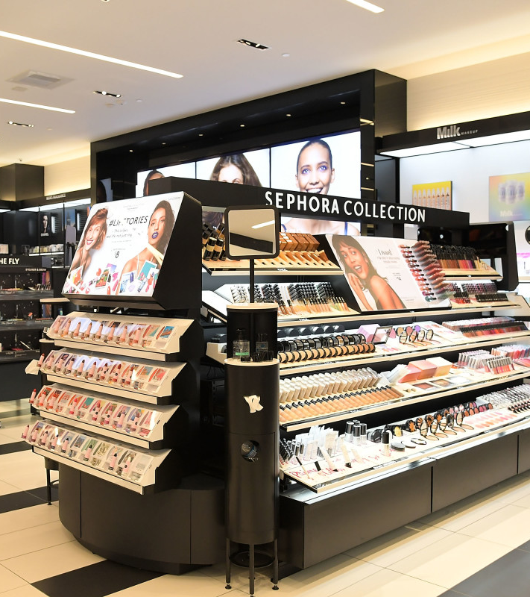
Store Layout, Design, and Visual Merchandising
Hedonic Product Focus:
  Fragrances, anti-aging skincare, and color cosmetics appeal to emotions and luxury self-care.
Free-Form Store Layout:
  Encourages exploration and comfort with an upscale, boutique fell – ideal for experiential shoppers.
Signage and Lifestyle Imagery:
  Clear category and brand signage paired with aspirational visuals to enhance navigation and emotional appeal.
Merchandising Fixtures and Displays:
  Strategic use of cash wraps, end caps, bundle displays, and wall merchandising to boost impulse and premium sales.
Atmosphere and Sensory Experience:
  Flattering lighting, curated music, subtle scents, and clean aesthetics promote relaxation and product focus.
Notes:
ABIGAIL AND SKYLAR
Hedonic Product Focus- ABIGAIL
Our merchandise strategy leans heavily on hedonic value—products that make customers feel good rather than just serve a need. For example, high-end anti-aging creams tap into emotional desires for youth and confidence, while fragrances and colorful makeup like highlighters or glitter liners fulfill personal expression and indulgence.
Free-Form Store Layout- ABIGAIL
We're opting for a free-form layout used by many upscale boutiques. It allows customers to browse comfortably, encourages movement, and creates an immersive, ever-changing shopping experience—perfect for the hedonic, "treat-yourself" mindset of our target market. While not as space-efficient and more prone to shoplifting, it aligns with our luxury brand image and customer expectations.
Signage & Lifestyle Imagery- SKYLAR
Category signage will direct shoppers to skincare, fragrance, haircare, and specific brands. Lifestyle imagery—like models with glowing skin or elegant perfume ads—helps shoppers visualize how the products enhance their own lives. We're not just selling beauty; we’re selling aspiration.
Merchandising Fixtures & Displays- SKYLAR
Cash wraps will be lined with minis and value items to encourage impulse buys. End caps will spotlight luxury brands like Chanel and Oribe to promote prestige and drive higher-margin sales. Promotional aisles will feature value kits and seasonal bundles, strengthening both sales and brand partnerships. Walls (our power perimeter) will display Sephora Collection and top-tier brands in a big, bold way.
Atmosphere & Sensory Experience- SKYLAR
Lighting will be bright and flattering to showcase skincare textures and makeup tones. Music will shift throughout the day—smooth R&B or soft pop in the evening to create a relaxed, upscale vibe. Subtle scents in the fragrance section will spotlight trending perfumes without overwhelming the senses. A mostly white color palette will enhance product focus, making the vibrant makeup pop and reinforcing Sephora’s signature aesthetic.

Slide 11
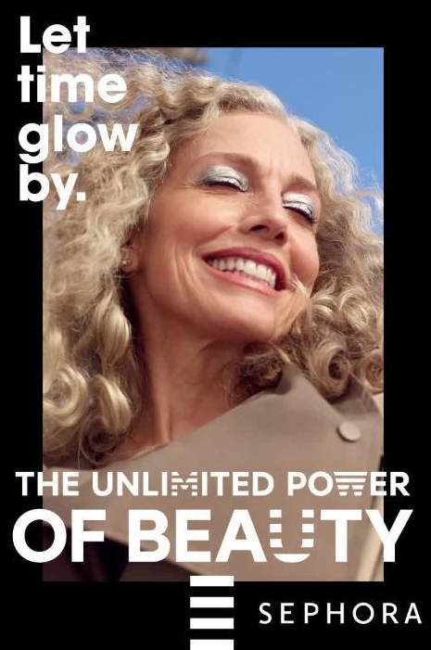
Retail Communication Mix
Advertising Strategy:
  Utilize billboard, town newspaper, and Chamber of Commerce platforms to build initial awareness.
Launch Promotions:
  Free high-end sample with $100+ purchase during opening week to drive traffic and spending.
Personal Selling:
  Beauty consultants provide tailored, in-person experiences to boost trust and satisfaction.
Online and Social Media Marketing:
  App notifications, email discounts, and local social media accounts to keep customers engaged.
Consideration and Trade-Offs:
  Traditional ads and social media have limitations – costs, crowded feeds, and short attention spans.
Notes:
MAEVE
Our retail communication mix consists of advertising, promotions, personal selling, online and social media marketing. To

Slide 12
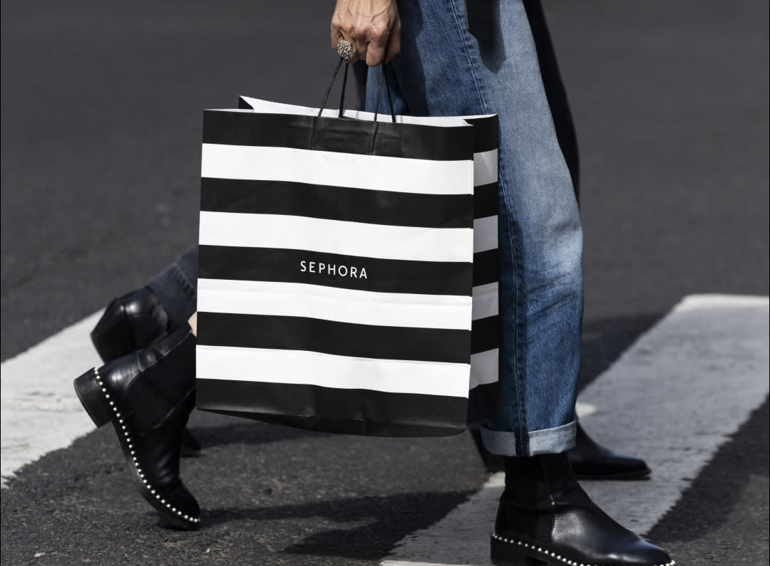
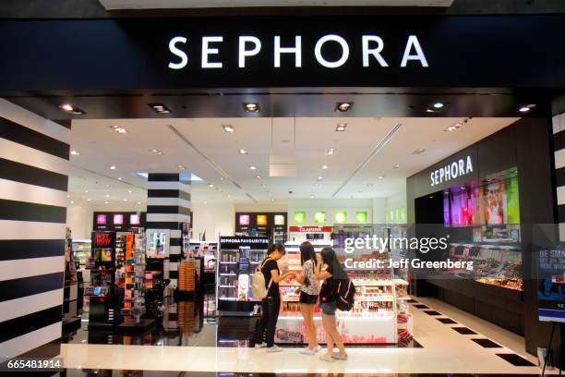
Managing Customers
Personalized CRM Approach:
  Leverage Beauty Insider program and skincare consultations to tailor product recommendations and build trust.
Use of RFM Analysis:
  Focus on recency to re-engage inactive customers through emails, offers, and exclusive product alerts.
Data Collection Strategies:
  Gather customer insights via consultations, loyalty data, and interactive quizzes or surveys.
Retaining Profitable Customers:
  Offer rewards like deluxe samples and event invitations to high-value, repeat buyers.
Managing and Preventing Unprofitable Behavior:
  Use sampling limits, starter kits, and education to discourage excessive returns or non-buying behaviors.
Notes:
ZOE
Personalized CRM Approach
Our mature target market values consistency and personal attention. That’s why we’ll heavily promote Beauty Insider sign-ups and offer personalized skincare consultations. We’ll track purchase history and preferences—so if a customer regularly buys SPF or anti-aging products, we can alert them when travel sizes or new formulas arrive.
Use of RFM Analysis
Of the RFM metrics, recency will matter most for us. Many of our older customers may shop less frequently, so recent visits are a stronger indicator of loyalty than frequency or total spend. If someone hasn’t returned in 60 days, we’ll send a gentle “We Miss You” message with relevant offers or a free sample opportunity.
Data Collection Strategies
We’ll collect data in respectful, non-intrusive ways. Mini consultations allow us to note concerns like dryness or sensitivity, while interactive surveys can reveal travel habits or product discovery paths. These methods provide zero-party data we can use to customize marketing and merchandising for Oxford’s local customer base.
Retaining Profitable Customers
Customers who consistently shop every quarter will be recognized through thank-you emails, exclusive product previews, or invites to themed events like “Skincare for Radiant Aging.” This deepens emotional connection and encourages continued loyalty with value-added services and recognition.
Managing & Preventing Unprofitable Behavior
We won’t penalize high-return customers outright—but we will gently nudge better habits by requiring Beauty Insider membership to access free samples or offering affordable starter kits. Preventative education also helps—staff will be trained to guide hesitant buyers to travel-size kits to reduce returns and boost product confidence.

Slide 13
Conclusion
Undeserved Market Opportunity:
Silver and Gold demographic in Oxford is overlooked by current beauty retailers focused on students.
Targeted, Trust-Based Brand Curation:
Offering familiar, age-friendly brands like Clinique, Chanel, and Supergoop tailored to mature shoppers.
Premium Location with Strategic Placement:
Conveniently located off Jackson Avenue near Belk, driving traffic while offering a refined alternative.
Beyond Product - Personalized Service:
Focus on consultations, loyalty rewards, and pricing that balances luxury and value.
Long-Term Community Connection:
Creating a store that feels personal, inclusive, and empowering for a loyal, high-value audience.
Notes:
REAGAN AND MAEVE
In conclusion, Oxford’s beauty retail landscape currently caters mostly to college students, leaving a gap for older residents who value personalized, quality care over trend-driven products. Sephora Oxford addresses this need by curating trusted brands like Clinique, Chanel, and Supergoop—favorites for mature skin focused on comfort, quality, and safety. Our strategic location off Jackson Avenue near Belk ensures convenience, visibility, and alignment with our target audience. More than just a store, Sephora Oxford will offer personalized skincare consultations, exclusive promotions, and loyalty perks—creating an experience rooted in trust and thoughtful service. By building strong community connections we’re positioned not just to open, but to grow and thrive in Oxford long-term.

Slide 14
Thank You! Questions?

